Slide 1
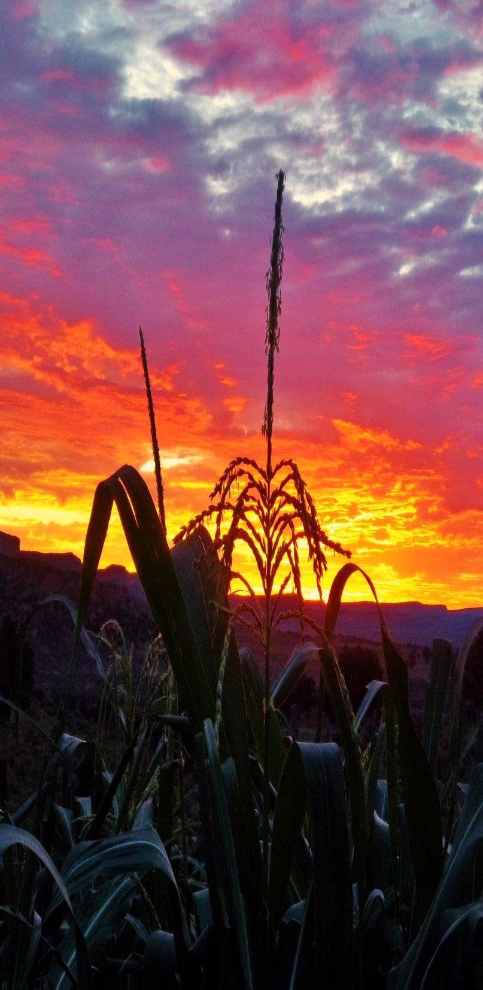
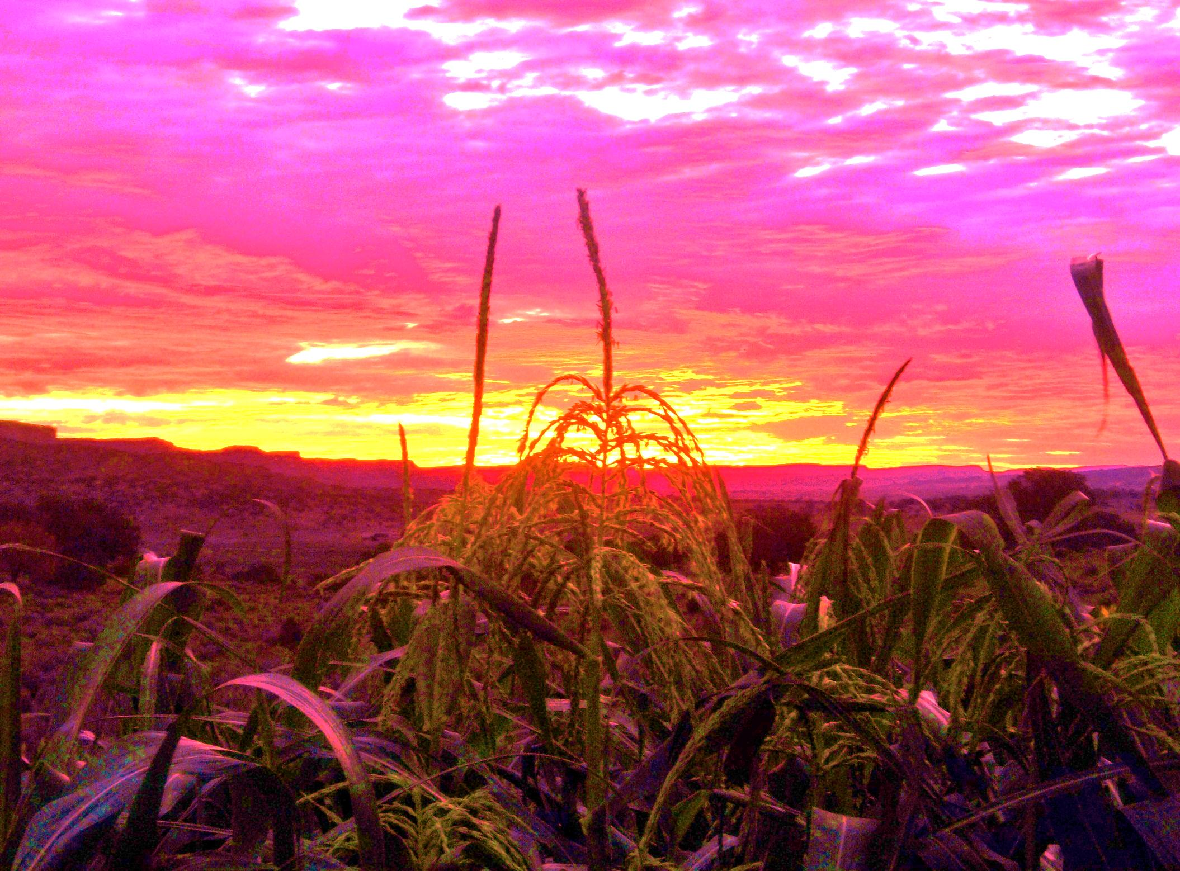
Siihodiindzin bee Na’nitin
Teaching by kinship with compassion and love

Slide 2

Siihodiindzin bee Na’nitin
Ya’at’eeh
Introduction of Teachings of Kinship with Compassion and Love
  Published by The Gallup Indian Medical Center
  To address the need for culturally sensitive approach
  To understand the impact of healing language

Slide 3
Siihodiindzin bee Na’nitin
The goal of Siihodiindzin Bee Na’nitin is to contribute to the promotion of culturally sensitive education on the topic of suicide-prevention efforts. Siihodiindzin Bee Na’nitin is based on the kinship-teachings of traditional Navajo people. Siihodiindzin Bee Na’nitin objectives
Make aware the risk factors for suicide in Navajo culture;
Identify the progression and signs of suicidal behavior;
Understand that intervention can begin with family and relatives;
Learn the process of intervention; and
learn the language of healthy kinship and communicate the wellness of social relations

Slide 4
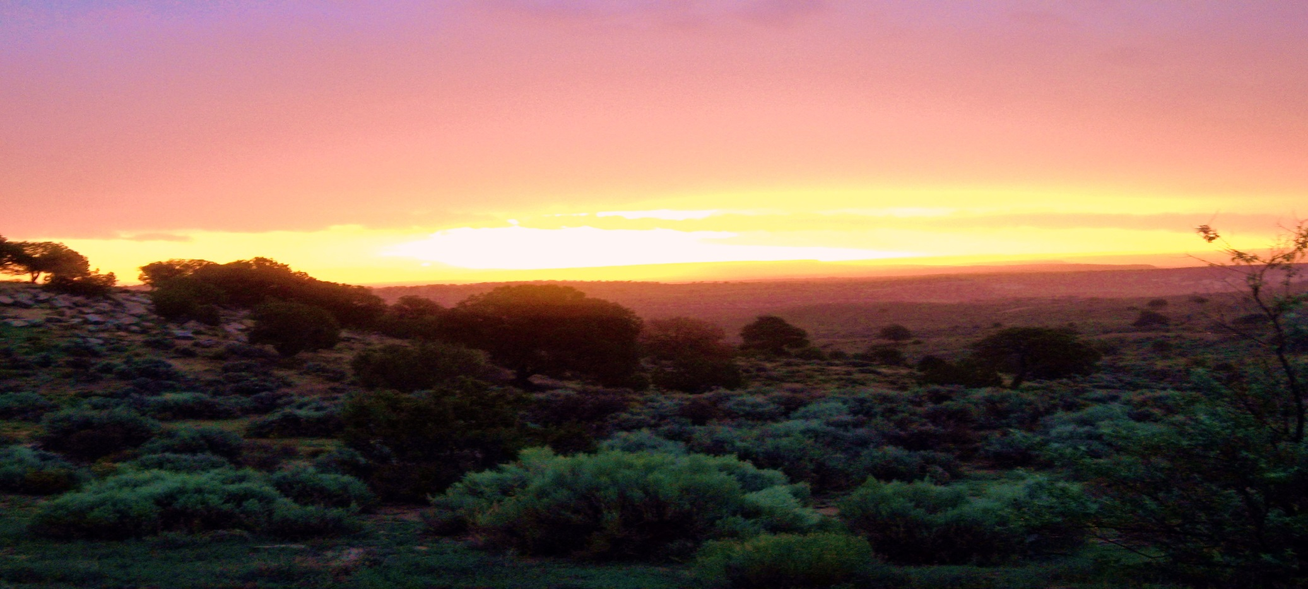
Siihodiindzin bee Na’nitin
How do we coincide and balance the important education of understanding suicide risk and behaviors between traditional Native American and western practices?

Slide 5
Siihodiindzin bee Na’nitin
2012 National Strategy for suicide prevention “goals and objectives for action” a report of the US General and of the national action alliance for suicide Prevention
Appendix D Groups with increased Suicide Risk
    American Indians/ Alaska Natives
    Individuals bereaved by suicide
    Individuals in justice and child welfare settings
    Individuals who engage in non-suicidal self-injury
    Individuals who have attempted suicide
    Individuals with medical conditions
    Individuals with mental and or substance use disorders
    Lesbian, gay, bisexual, and transgender (LGBT) populations
    Members of the Armed Forces and Veterans
    Men in midlife and older men

Slide 6
Siihodiindzin bee Na’nitin
How many Native American youth are affected with at risk, suicidal behavior, and how many people are we talking about?
  Suicide is the second leading cause of death among AI/AN peoples aged 10-34 years
  Native Men aged 19-24 having the highest rate of suicide in AI/AN populations
  Specific risk factors attributed to suicide include; Alcohol/Substance use, discrimination, limited mental health services access and use, and historical trauma

Slide 7
Siihodiindzin bee Na’nitin
Suicide risk and specific mental and substance use disorders include;
  Mood disorders-most common and most life threatening psychiatric illness
  Major depressive disorder
  Bipolar disorders, manic depressive illness
  Borderline personality disorder
  Schizophrenia- disturbances in perception, thought, language and social function

Slide 8
Siihodiindzin bee Na’nitin
Substance Use Disorders
  Alcohol and drug abuse are second only to depression and other mood disorders as the most frequent risk factor for suicide;
  More than 45% of youth identified with alcohol and substance use disorders die by suicide
  Most identified comorbid psychiatric condition is post traumatic stress disorder PTSD

Slide 9

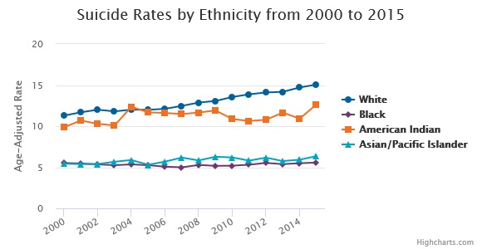
Siihodiindzin bee Na’nitin

Slide 10
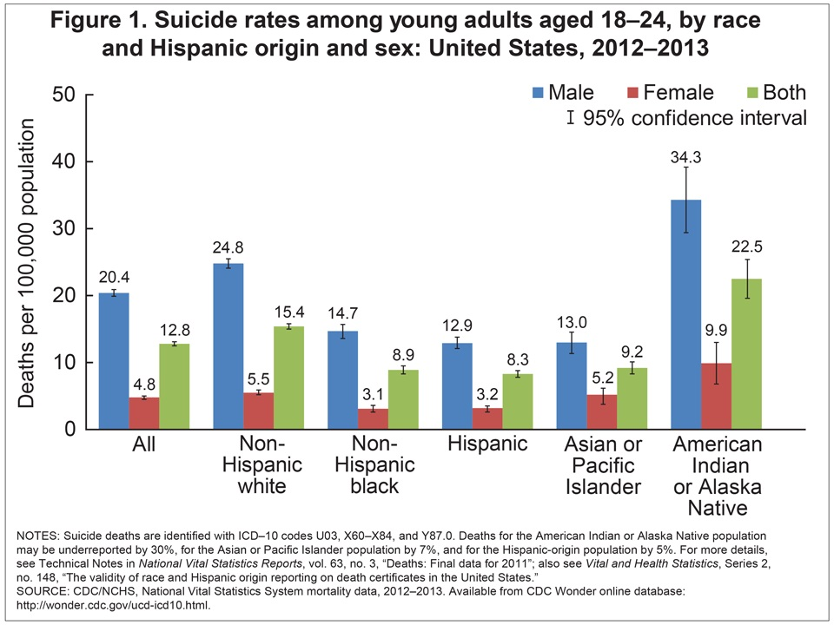
Siihodiindzin bee Na’nitin

Slide 11
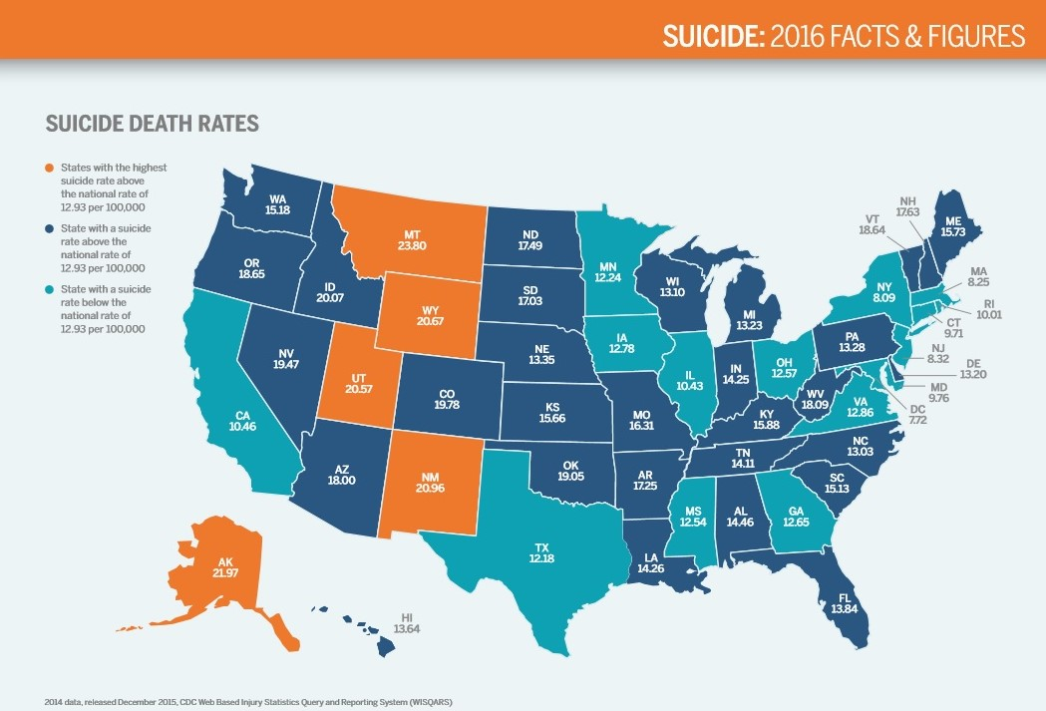

Slide 12
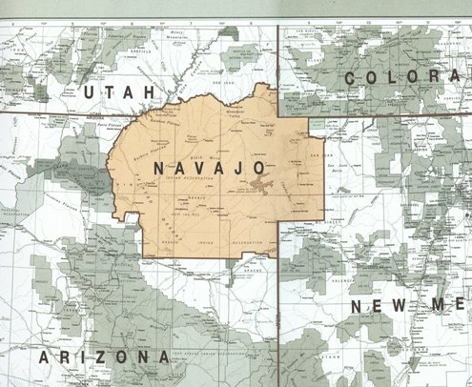
Siihodiindzin bee Na’nitin

Slide 13
Siihodiindzin bee Na’nitin
Current stats in Utah
Current response procedures/ practices in UT
What percentage comprise of Native American Youth?
Current Facilities
    2010 Census results
    Total population of UT 2010 census 2,763,885
    1% is Native American
    16.2% are between the ages of 10-19 years old

Slide 14
Siihodiindzin bee Na’nitin
Current stats in AZ
Current response procedures/ practices in AZ
What percentage comprise of Native American Youth?
Current Facilities
    Total population of AZ 2010 Census 6,392,017
    4% are Native American
    14.2% are between the ages of 10-19 years old

Slide 15
Siihodiindzin bee Na’nitin
Current stats in NM
Current response procedures/ practices in NM
What percentage comprise Native American Youth?
Current Facilities
    Total population of NM 2010 census 2,059,179
    8.5% are Native American
    14% are between the ages of 10-19 years old

Slide 16
Siihodiindzin bee Na’nitin
Is there an unmet need?
  If, In 2016, The 2rd National ranking cause of death in the US for persons 44 years and younger is Suicide, &
  Suicide rate among AI/AN adolescents and young adults between the ages of 15-24 is more than 1.5 times higher than the National US average,
Then, yes there is an
UNMET NEED!

Slide 17
Siihodiindzin bee Na’nitin
  The Navajo Nation is directly affected by suicide outcomes
      Resources
      Facilities that directly address this need
      Deficiency of adequate staff
      Cultural loss and Dissonance

Slide 18
Siihodiindzin bee Na’nitin
  Identifying and addressing the importance of cultural loss and dissonance, there are two key points that are of utmost important to understanding the current social and cultural context directly impacting Native American Suicide
      Historical Trauma
      Intergenerational Trauma

Slide 19
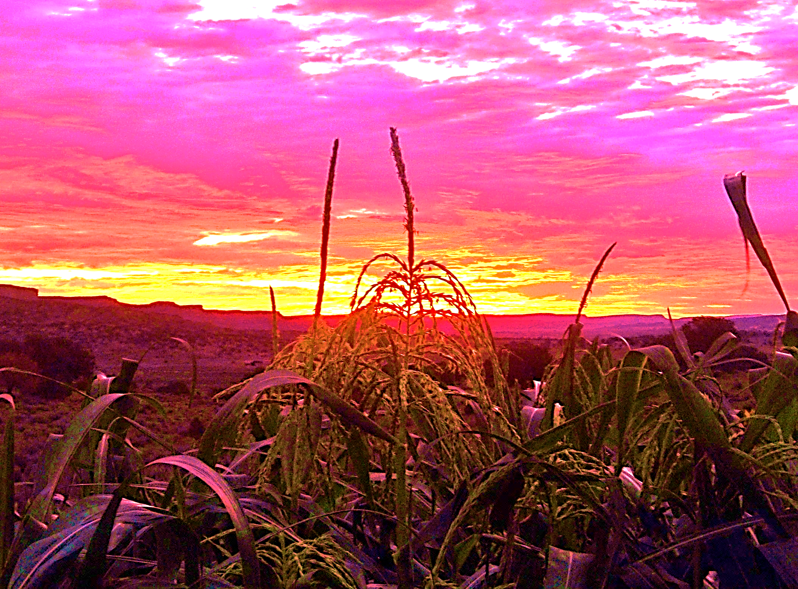
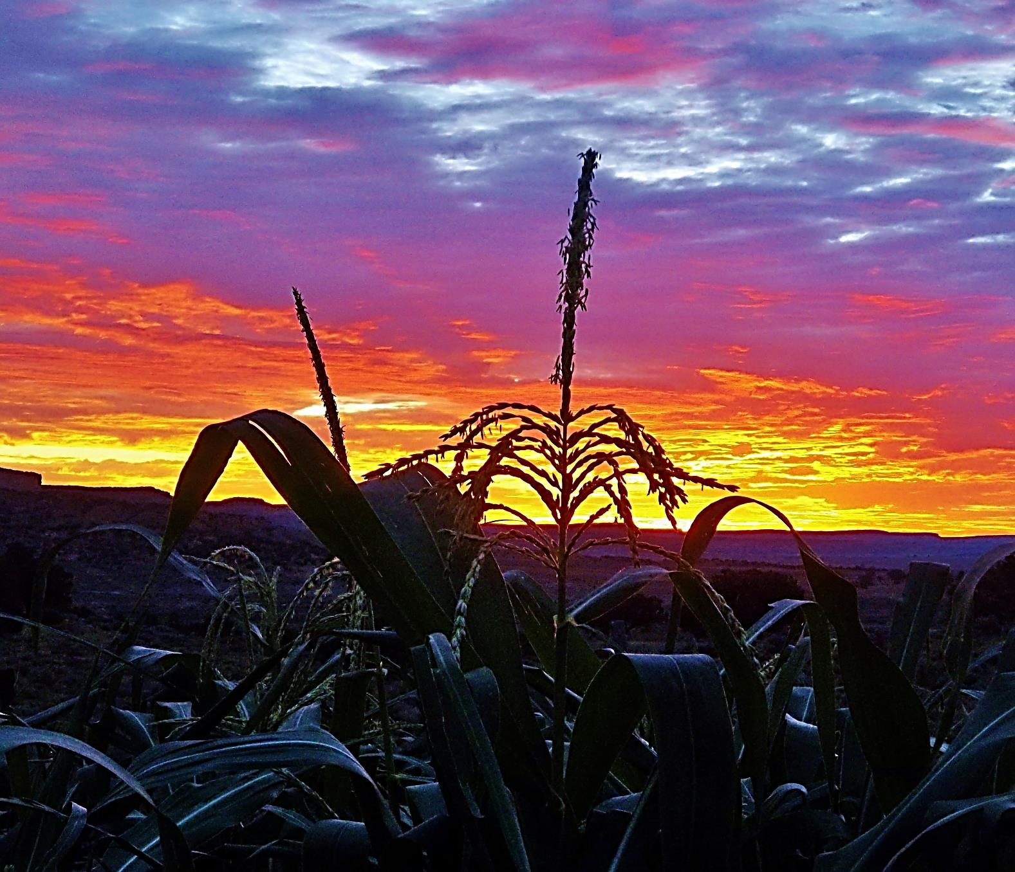
Siihodiindzin bee Na’nitin

Slide 20
Siihodiindzin bee Na’nitin
Our approach the subject of Suicide;
1) Distinguish the Dialectical Syntax
    Exposure v/s attachment (intrinsic)
    Attachment v/s response (extrinsic)

Slide 21
Siihodiindzin bee Na’nitin
Our approach the subject of Suicide;
2) Affirm and validate the healing language
    Identify what traditional healing words are currently available
    Identify what traditional healing words are currently absent
    Familiarity v/s reintroduction

Slide 22
Siihodiindzin bee Na’nitin
Our approach the subject of Suicide;
3) Adapt Literature and Research Recognition
    Cognitive dissonance brought by misleading and miscommunications = manifestation of outcome
    Increase in suicide, depression, maladaptive behaviors
    Address a myriad of issues

Slide 23
Siihodiindzin bee Na’nitin
Our approach the subject of Suicide;
4) Classify accessible resources with alignment to actual needs and demography
    Previous Suicide Attempt
    History of a Prior or Ongoing Psychiatric Disorder
    History of Sexual or Physical Abuse
    History or Exposure to Violent Behavior
    Family History of Suicidal Behavior or Mood Disorders
    Biological Factors, Including Male Sex and Gay or Lesbian Sexual Orientation

Slide 24
Siihodiindzin bee Na’nitin
Our approach the subject of Suicide
5) Understand other co-occurring phenomena
    Hopelessness
    Persistent depression/grief
    Psychotic experiences
    Physical/ mental/spiritual/emotional induced changes

Slide 25
De’áyónik’ehgo Dighááh
The impelling process of disassociation from kinship
Symptom Based
Suicidal Predispositions
  Frequency of suicidal tendencies
Suicidal Thoughts
  Psychological impairment
All-inclusive based
Kadighááh
  Sustaining Injury; the onset of suffering
Anitsékees Yiildiłgo
  When the thinking is wounded

Slide 26
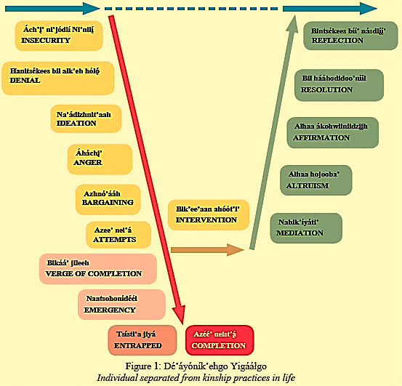
Kadighááh

Slide 27
Siihodiindzin bee Na’nitin
  Psychosocial Issues
    Why is suicide not discussed?
      Taboo?
        Taboo exists in Western philosophies not Traditional Navajo language or culture
          Subject was addressed and mediated through the cultural healing language before Western applications

Slide 28
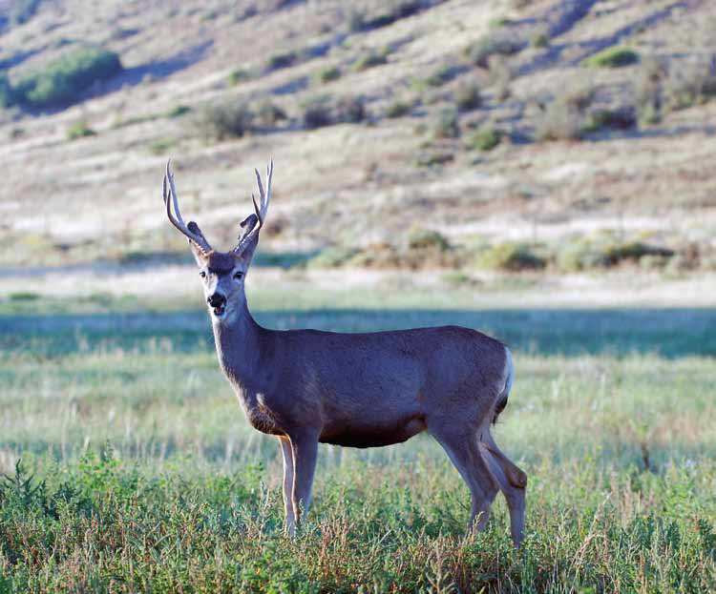
Siihodiindzin bee Na’nitin
  Psychosocial Issues

Slide 29

Siihodiindzin bee Na’nitin
  Psychosocial Issues
    Is dialectical syntax responsible? In Navajo culture, maybe.
      Dialectical Syntax
        Subordination of Traditional to Dominant Culture
        Generational Trauma
          Initiatives
            War
            Relocation
            Boarding Schools

Slide 30
Siihodiindzin bee Na’nitin
Talk Crisis
Prevention
Fact: A person who is serious about suicide will sometimes telegraph their intent through their speech.
Myth: If we don’t allow the conversation then they won’t do it.
This code of silence generalizes to talk aimed at prevention, intervention and post-vention as well.
Acknowledgement of family systems
Allowing generations to reconnect the emotions with healing language and be the bridge to express those ideas in English to future generations.
Reconnecting with family, earth and this life; providing hope in the place of despair as an adaptive pro-life mechanism.

Slide 31
Siihodiindzin bee Na’nitin
What is the importance of this paradigm?
Navajo healing language based curriculum designed to realign families with their unique language.
  Inspires
        Historical relationship
        Imagery
        Topic specificity
        Pride and Hope
    Connection to
        Family Systems
        Kinship
        Personal connection in family, life and existence
    Compassion and love for self and others

Slide 32
Siihodiindzin bee Na’nitin
How revolutionize current counseling approaches?
    Siihodiindzin Bee Na’nitin specifically supports the importance of bridging elder life resourcefulness as a means to provide improved well-being for disconnected adults and youth. Siihodiindzin Bee Na’nitin is based on traditional Navajo life-ways, emphasizing a suicide prevention paradigm and is intended to provide a healthy, prevention education platform. Siihodiindzin Bee Na’nitin harnesses traditional Navajo pro-life knowledge of teaching compassion, love and kinship to support and facilitate a strong prevention based dialogue, and to initiate constructive family interactions in order to address, and educate the dangers of self-harm and self-injurious behaviors, with respect to culture, family attitudes, knowledge, belief and behaviors.

Slide 33
Siihodiindzin bee Na’nitin
How is this information relevant (implications)?
  The contribution that generational trauma and government initiatives provide to the psyche of the individual
  The importance of alignment of symbolic language with emotion, so emotion can be addressed.
  The value of kinship roles and how generational hierarchy provides certain protections as well as entitlements and responsibilities for every single member of a family and community.
  That suicide is a symptom not a pathology. The pathology is anxiety that has been exacerbated by initiatives counter-aligned with Navajo culture ideals.

Slide 34
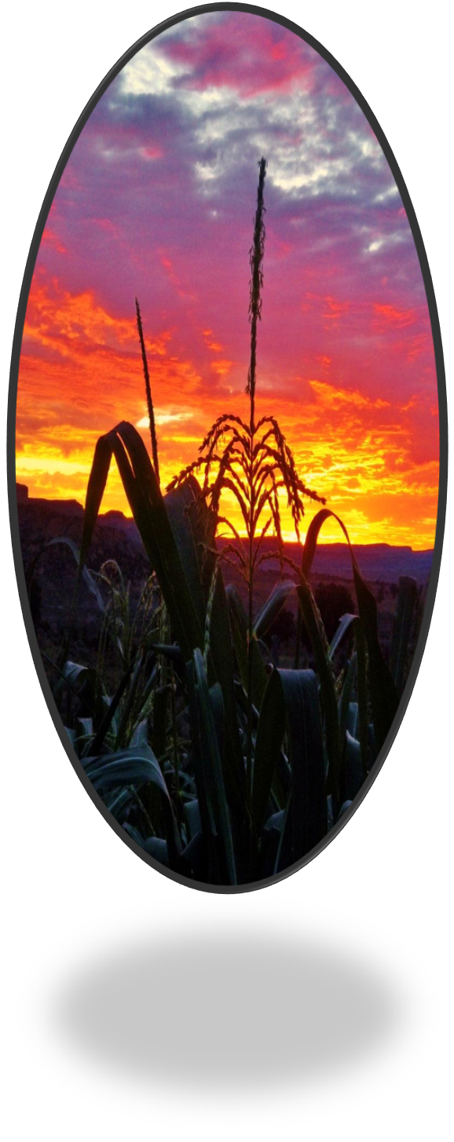
DSP SBN
Pre and Post Questionnaire Data outcomes FY 2015, 2016, 2017
Eric Willie MA
Siihodiindzin Bee Na’nitin

Slide 35
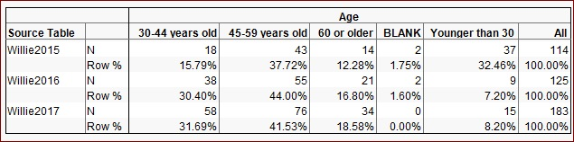
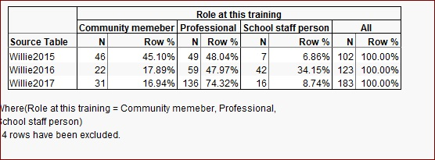
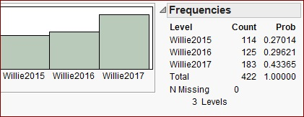

Slide 36
I am able to recognize signs that someone is at risk of attempting suicide
Before
After

Slide 37
I understand the stages of dissociation from kinship
Before
After

Slide 38
I understand the stages of intervention to use with a person who may be considering suicide.
Before
After

Slide 39
I am comfortable talking openly about suicide and suicide prevention.
Before
After

Slide 40
How prepared would you be in helping a person with suicidal intentions?
Before
After

Slide 41
How comfortable would you feel in helping a person showing suicidal intentions?
Before
After

Slide 42
How confident are you that you would try to help a person showing suicidal intentions?
Before
After

Slide 43
Siihodiindzin bee Na’nitin
How do we coincide and balance the important education of understanding suicide risk and behaviors between traditional Native American and western practices?

Slide 44

Siihodiindzin bee Na’nitin
Questions

Slide 45
Siihodiindzin bee Na’nitin
For More information contact
GIMC Health Promotion
June, Adeline MSPI Coordinator
516 E Nizhoni Blvd
Gallup NM, HP-Building #2010
505-722-1267
Adeline.June@IHS.gov

Slide 46
Siihodiindzin bee Na’nitin
Ahéhee
Ericke Lewis Willie, MA
PO Box 733
Churchrock, NM 87311
meblue@hotmail.com

